Slide 1
RISK GAME - BUILD 3 IMPLEMENTATION TEAM 25

Slide 2
Risk Game - What is it ?
RISK
Is a strategic board game played against 2 to 6 players. The main aim is to attack and conquer the neighboring territories.
The winner is declared when a player conquers all the territories in the map.
Rules focused on for this Build
Conquer all to win.
Always a connected graph.
Attack only adjacent territories.
Provide armies at the start of every turn based on holding cards, territories and continents owned.
‘N’ Number of attack moves.
Move armies once to fortify.

Slide 3
Introduction
1
~To The Build Requirements

Slide 4
Functional Requirements:
Map – Load and Reject.
Gameplay –Tournament Mode
Save/Load – Save or Load the Game State.

Slide 5
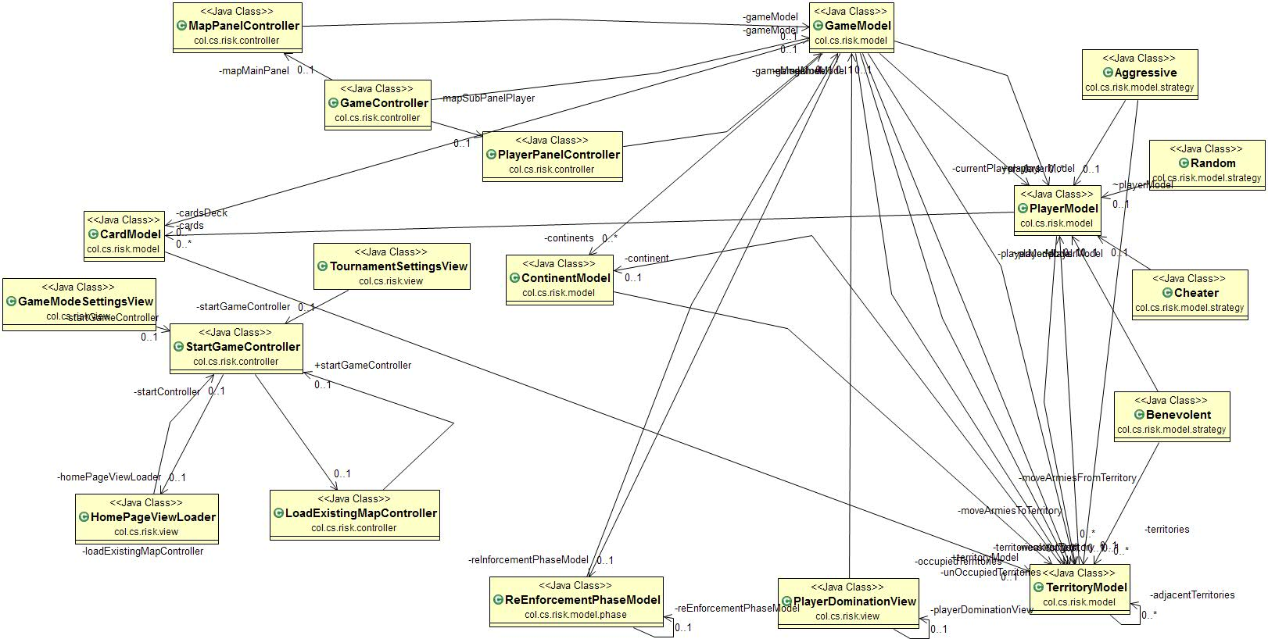
Proposed Architecture

Slide 6
Proposed Solution
Based on each requirement, we will display the code and demo in a proper and elegant manner.

Slide 7
Map Editor– Load or reject
Based on the rules of the Risk Game, a map is properly validated before loading it onto the UI.
If a map is deemed invalid, it will not be produced. Rather, rejected.

Slide 8
RISK Build1
A DEMO of Map Editor.

Slide 9
Gameplay Phase - Tournament
A mode that doesn’t involve any human interaction.
User may choose attributes such as the number of games, turns and maps.
Here, The user is also presented with the option of choosing the strategy plan.
This includes Cheater, Benevolent, Aggressive and Random;

Slide 10
RISK Build1
A DEMO of Gameplay Phase.

Slide 11
Save and Load
The game maybe saved mid-way through the gameplay.
This is done by saving the attributes of the game to a file.
The saved may later be loaded to resume from the same spot as previous.

Slide 12
RISK Build1
A DEMO of Save/Load Feature.

Slide 13
Thanks!
Any questions?

Slide 14
References
https://tallyfy.com/uml-diagram/
http://www.extremeprogramming.org/
https://users.encs.concordia.ca/~paquet/wiki/index.php?title=SOEN6441_-_fall_2018

